Slide 1

Income Classification using Adult Census Data
1
DS 861 - Data Mining and Advanced Statistical Methods for Business Analysts Group Project - Spring 2023 - Professor Minh Pham
By:
Saksham Motwani
15 May 2023

Slide 2
Agenda
2
Objective
Dataset Description
Data Preprocessing
Cleaning
Feature Engineering & Feature Selection
Exploratory Data Analysis
Data Preprocessing - Encoding Categorical Variables
Models & Techniques
Results & Conclusions
Final Thoughts
Q&A

Slide 3
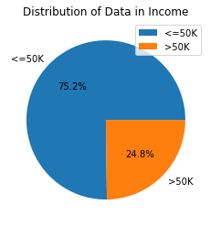
Objective
3
For this project, we are trying to predict whether an individual’s income will be greater than $50,000 per year based on several attributes from the census data. A binary classification problem.
There is imbalance in the response variable.
First we explore the data at face value, then clean and transform the data, and finally train the data on 4 different models - Logistic Regression (5-Fold CV with threshold tuning), Decision Trees, Random Forest Classifier and Gradient Boosting Classifier (all with 5-Fold CV & hyperparameter tuning).
We also compare models based on their F1 Score.

Slide 4
Adult Census Income - Dataset Description
4
Fetched from UCI ML repository.
48,842 entries extracted from 1994 US Census database. Each entry contains the following information about an individual
Categorical (8+1) - workclass: represents employment status State-gov, Self-emp-not-inc, Private, Federal-gov, Local-gov, Self-emp-inc, Without-pay, Never-worked - education: highest level of education Bachelors, HS-grad, 11th, Masters, 9th, Some-college, Assoc-acdm, Assoc-voc, 7th-8th, Doctorate, Prof-school, 5th-6th, 10th, 1st-4th, Preschool, 12th - marital-status Never-married, Married-civ-spouse, Divorced, Married-spouse-absent, Separated, Married-AF-spouse, Widowed - occupation: general type of occupation Adm-clerical, Exec-managerial, Handlers-cleaners, Prof-specialty, Other-service, Sales, Craft-repair, Transport-moving, Farming-fishing, Machine-op-inspct, Tech-support, Protective-serv, Armed-Forces, Priv-house-serv - relationship: represents what this individual is relative to others Not-in-family, Husband, Wife, Own-child, Unmarried, Other-relative - race White, Black, Asian-Pac-Islander, Amer-Indian-Eskimo, Other - sex Male, Female - native-country: country of origin 41 countries, however majority category is United-States - income: whether or not an individual makes more than $50,000 annually <=50K, >50K
Numeric (6) - age: integer greater than 0 - fnlwgt: final weight. integer greater than 0 weight assigned by the census bureau. allocate similar weights to people with similar demographic characteristics - education-num: highest level of education Label encoding of education (redundant) - capital-gain: capital gains for a person (integer>0) - capital-loss: capital loss for a person (integer>0) - hours-per-week: hours an individual reported to work

Slide 5
Data Preprocessing - Data cleaning
5
So to begin with, our dataset did not contain NaN values, but after we observed more closely, we found out that there were lot of ‘?’ values in the workclass (2799 instances), occupation (2809 instances) and native-country (857 instances) columns.
We replaced these ‘?’ values with NaN, treated them as missing values, and decided to drop them.
After dropping them, our dataset had 45222 observations and 15 features.
We also checked for duplicates and dropped them. Finally, our dataset had 45175 observations and 15 features

Slide 6
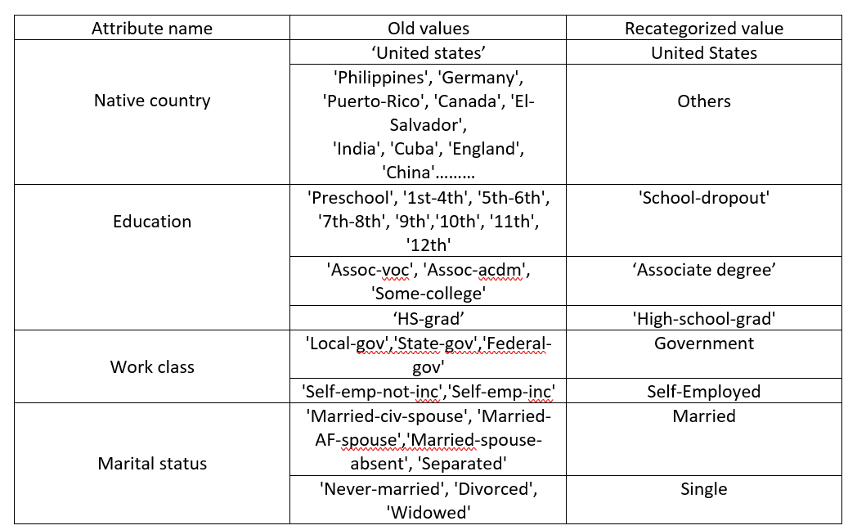
Data Preprocessing - Feature Engineering & Feature Selection
6
We decided to re-categorize some features in categories in a way with a minimal loss of information and dropped the ‘education-num’ column, since that was just redundant (label-encoded form of education) and proceeded for EDA

Slide 7
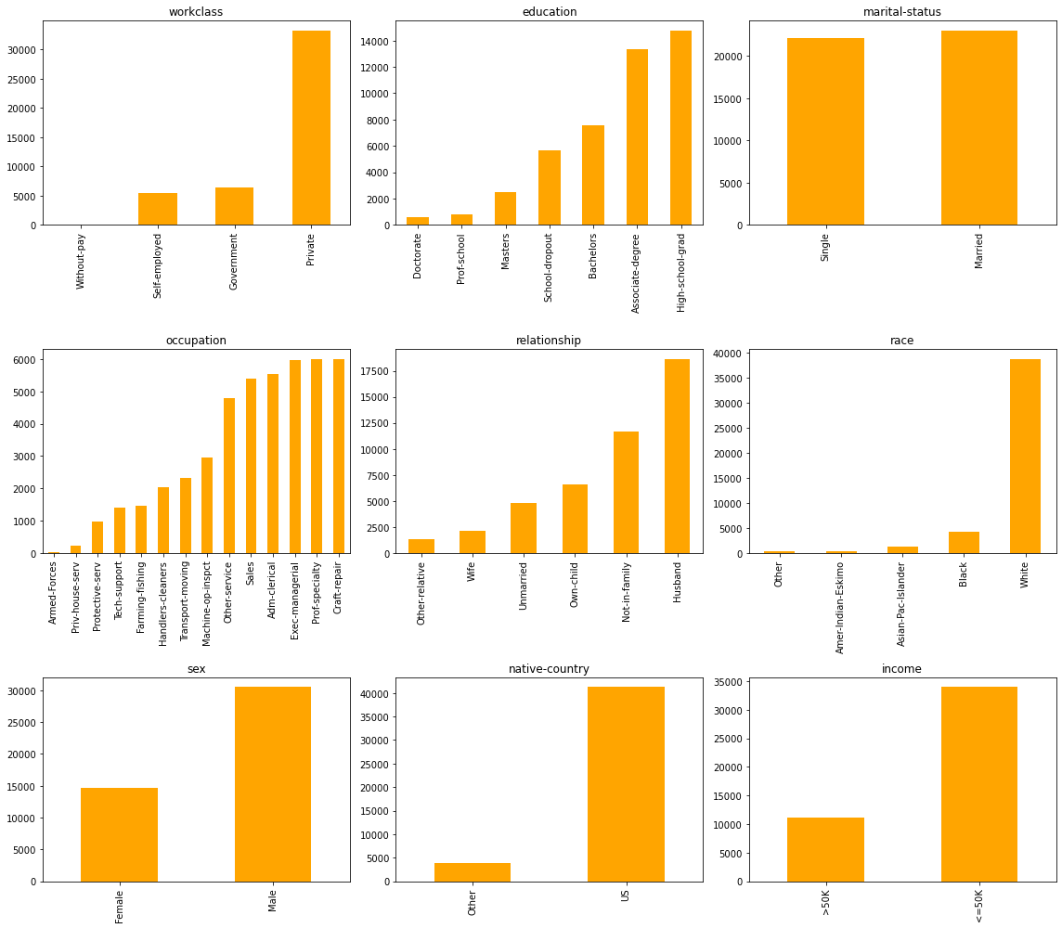
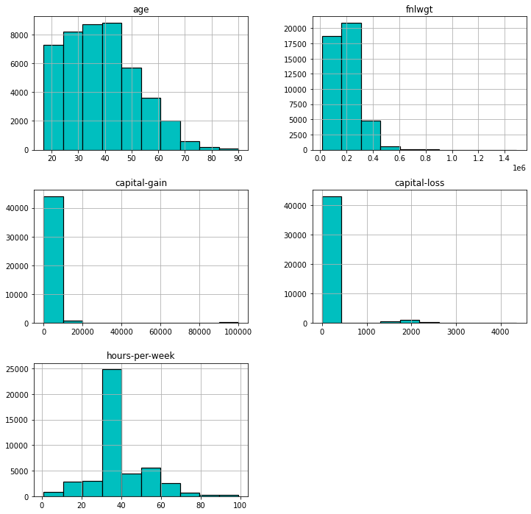
Exploratory Data Analysis
7
Distribution of categorical features
Distribution of numeric features

Slide 8
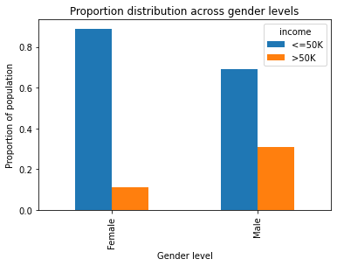
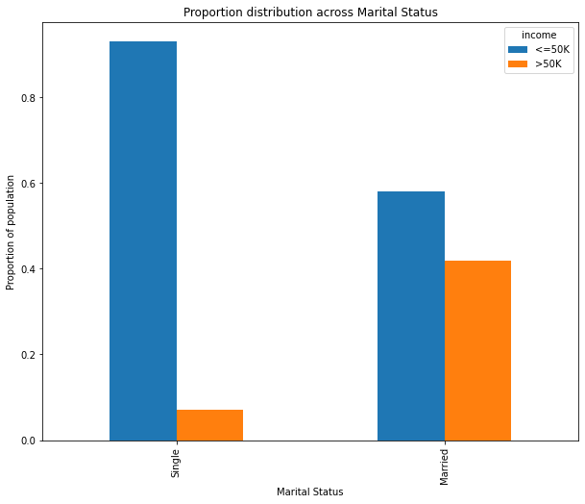
Exploratory Data Analysis
8
It can be observed that the proportion of men who earn over $50,000 annually is more than double of their female counterparts.
Proportion of married people who earn over $50,000 annually is much higher than the proportion of single people who earn more than $50K annually.

Slide 9
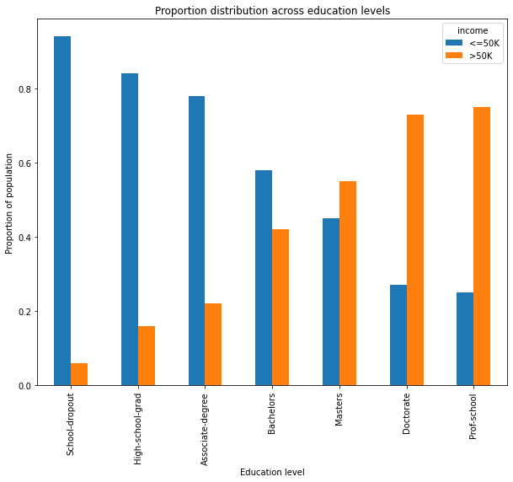
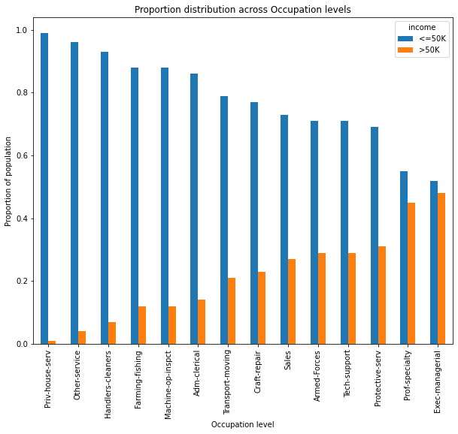
Exploratory Data Analysis
9
We can see that for occupations such as 'Prof-specialty' and 'Exec-managerial', the proportion of people whose salary is higher than 50k per year is more than other occupations.
This graph shows the proportion of income classes across education levels. As expected, as the education level increases, the proportion of people who earn more than 50k a year also increases. But what is interesting is that only after a masters degree the proportion of people earning more than 50k a year is a majority.

Slide 10
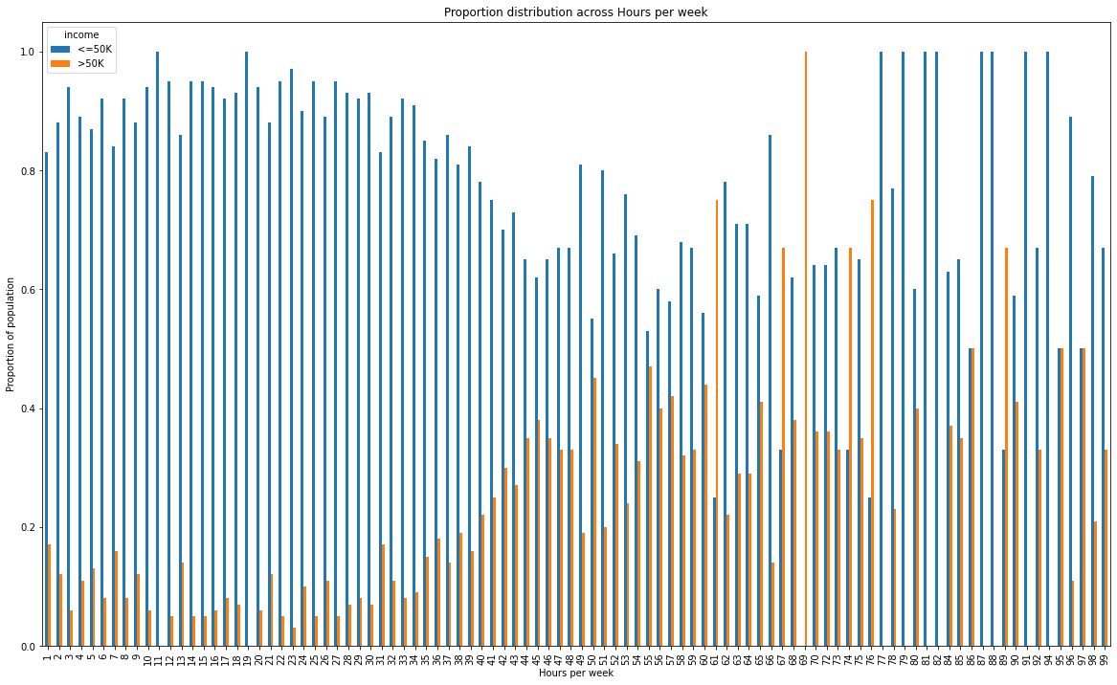
Exploratory Data Analysis
10
It was anticipated that there would be a correlation between the number of hours worked per week and the percentage of the population earning over 50k annually, but this was not consistently observed in the graph. Specifically, there were instances (such as when individuals worked 77, 79, 81, 82, 87, or 88 hours per week) where nobody earned more than 50k per year

Slide 11
Data Preprocessing - Encoding Categorical Variables
11
Since our dataset contains categorical variables, it was important to handle them before we train our models.
We created dummy variables for each categorical variable. (education, workclass, sex, race, native-country, occupation, marital-status, relationship, income)
The reference values we chose (to allow easy interpretability) for each variable are workclass - Government education - School-dropout marital-status - Single occupation - Craft-repair relationship - Unmarried race - Other sex - Female Native-country - Other income - <=50K
We drop reference columns and our dataset (features) dimensions are (45175,39)
We split the data into 80% training, 20% test, perform scaling on the numerical features to fit in the statsmodels logistic regression function.

Slide 12
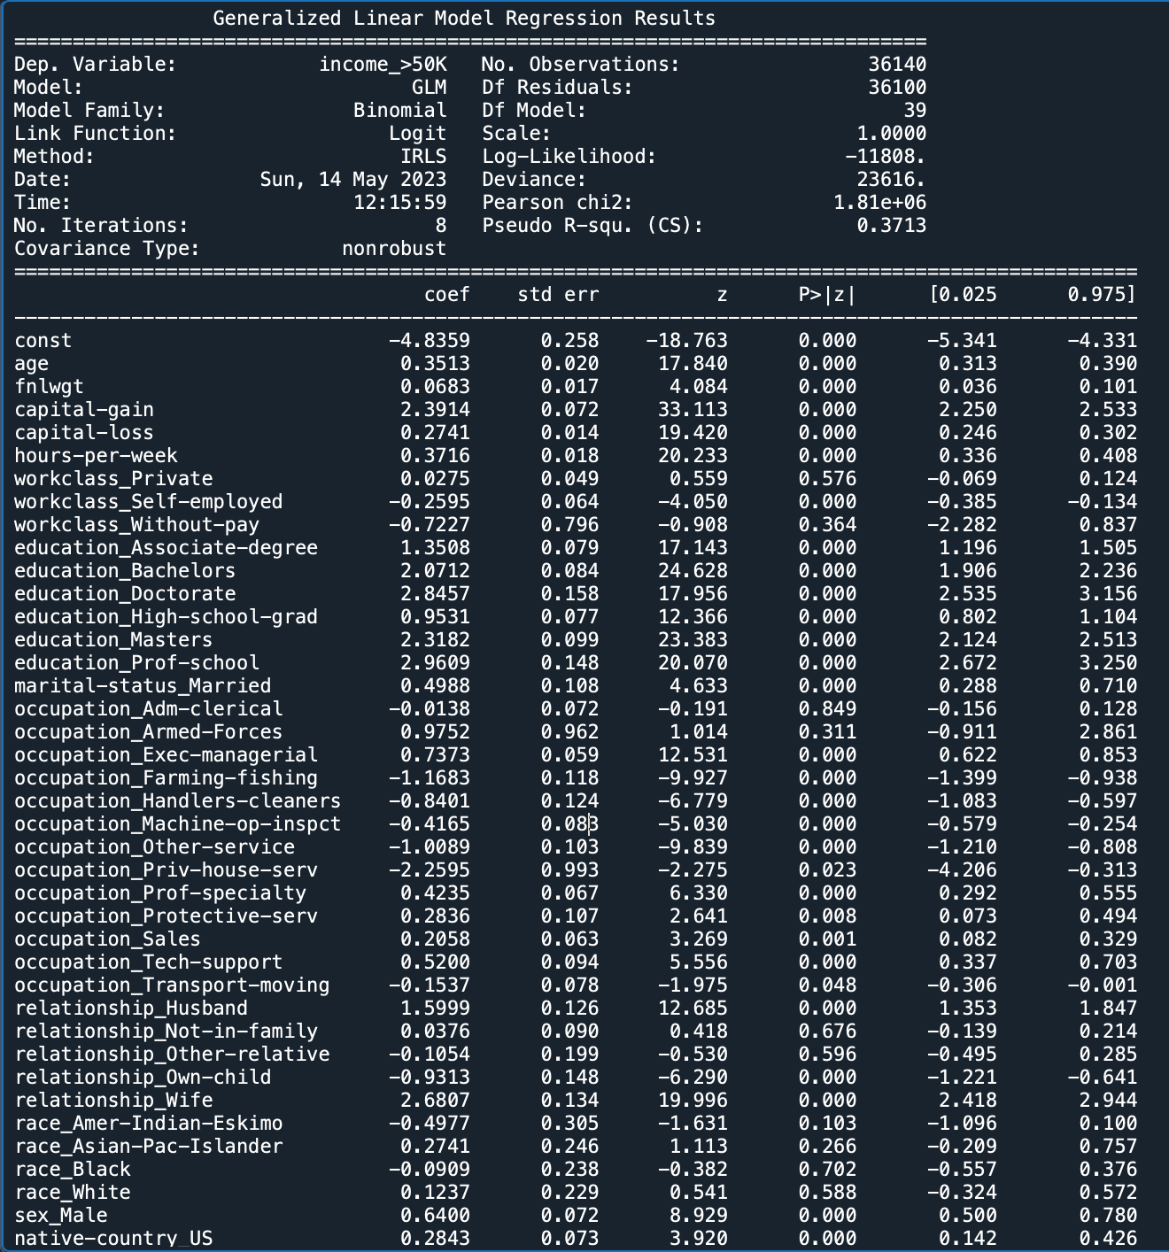
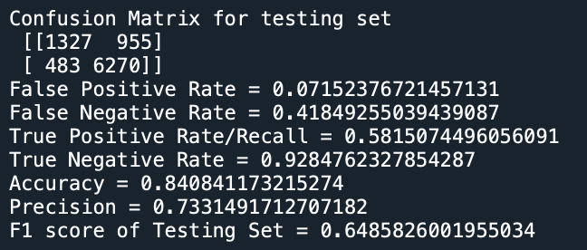
Logistic Regression Models - Stats models & train-test split
12
Insignificant features: workclass_private, workclass_Without-pay, occupation_Adm-clerical, occupation_Armed-Forces, relationship_Not-in-family, relationship_Other-relative, race_Amer-Indian-Eskimo, race_Asian-Pac-Islander, race_Black, race_White
Some interpretations of significant features: - Odds of income being >50K incr. by 42% for each 1 std. dev. incr. in age - For men, odds of income being >50K incr. by 90% (w.r.t women) - Odds of income being >50K incr. by 159%, 286%, 693%, 915%, 1831%, 1621% for HS grad, Assoc. degree, Bachelors, Masters, Prof-school, and Doctorate respectively (compared to school dropout) - For married, odds of income being >50K incr. by 65% (w.r.t single)
Metrics (using Sklearn), train-test split, w/o threshold tuning
- FN (955) > FP (483): Higher tendency to miss positive samples than incorrectly classify negative samples. - Low FPR - High FNR - difficulty identifying positives
- Recall (proportion of actual positives that are correctly identified as positive by the model) - 0.58 (not a high recall rate) - Accuracy - 84% - may not be a good metric since class dist. is imbalanced - Precision (proportion of positive predictions that are correctly classified by the model) - 0.733 (decent) - F1 score - 0.648 (can be improved)

Slide 13
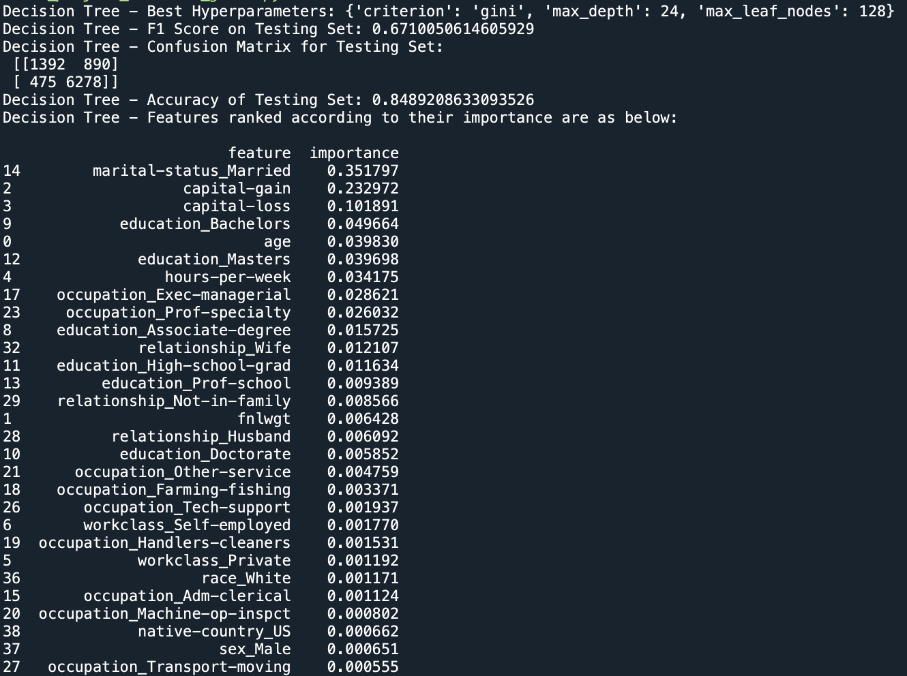
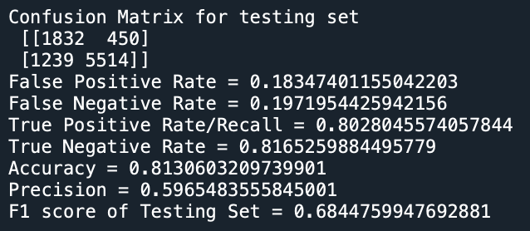
Logistic Regression Model - 5-Fold CV & Threshold tuning
Decision Tree Model - 5-Fold CV & Hyperparameter tuning
- Tuned 3 parameters: max_depth, max_leaf_nodes, criterion - max_depth: no. of levels. limits number of splits and prevents overfitting. Candidate values - np.arange(2,50,2) - max_leaf_nodes: sets max. leaf nodes in the tree. limits tree complexity and prevents overfitting. Candidate values: [2, 4, 8, 16, 32, 64, 128, 256, 512, 1024] - criterion: measures quality of split. Candidate values: gini, entropy
- Since the response variable is imbalanced, we tune the threshold value to remove the bias towards the majority class. We tune for the threshold that maximizes the F1 score. - 50 candidate values for threshold taken from 0 to 1 - Best threshold value that maximizes validation set F1 score = 0.28
Metrics on Testing Set
Metrics on Testing Set
- Performed worse than Logistic Regression - Best hyperparameters: 'criterion': 'gini', 'max_depth': 24, 'max_leaf_nodes': 128 - F1 score is slightly higher (0.671) -> overall a lesser performing model - Imp features: marital-status_Married, capital-gain, capital-loss
- Performed better than the previous model - Recall is higher (0.803) -> better at correctly identifying higher proportion of positive cases - Precision is slightly lower (0.597) -> expected because threshold value is tuned to optimize F1 score - F1 score is higher (0.684) -> overall a better performing model
13

Slide 14
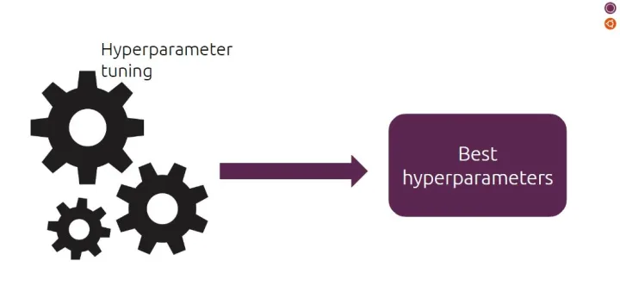
Hyperparameter tuning on Random Forest
14
GridSearchCV : .GridSearchCV performs an exhaustive search over a specified grid of hyperparameters.
RandomizedSearchCV : .RandomSearchCV, on the other hand, randomly samples from a distribution of hyperparameters for a fixed number of iterations. With a 100 iterations, we got the below parameters

Slide 15
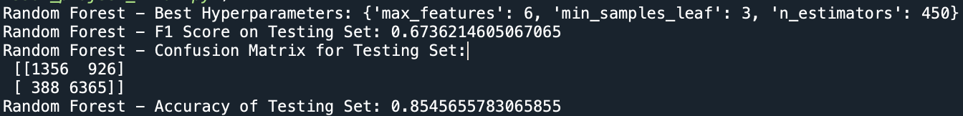
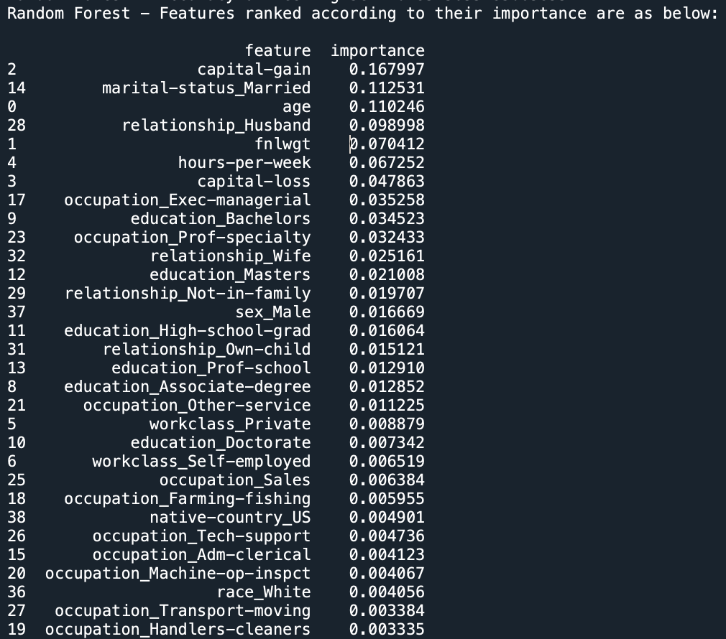
Random Forest Model Evaluation
15
Following is model evaluation of Random Forest model on Census data using GridSearchCV using 5-Fold CV.
The F1 score of 0.673, which represents the harmonic mean of precision and recall, indicates the balance between the two metrics. It suggests that the classifier achieves a reasonable trade-off between correctly identifying positive instances (precision) and capturing all positive instances (recall).
An Accuracy of 0.8567 indicates that the classifier is able to correctly classify approximately 85.67% of the instances in the testing set.
In summary, the results suggest that the Random Forest classifier with the specified parameters and 5-fold cross-validation demonstrates a reasonable ability to handle the binary classification problem.
Best parameters : max_features: 6, min_samples_leaf: 3 n_estimators: 450.
Performed better than DT but still not as good as Log regression.
Imp features : capital _gain , marital-status _Married, age
Notes:
Maximizing the F1 score during the training and evaluation process, you prioritize the classifier's ability to handle imbalanced classes, where one class may have fewer instances than the other. The F1 score is particularly useful in such cases as it considers both false positives and false negatives.

Slide 16
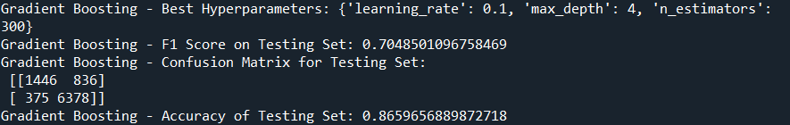
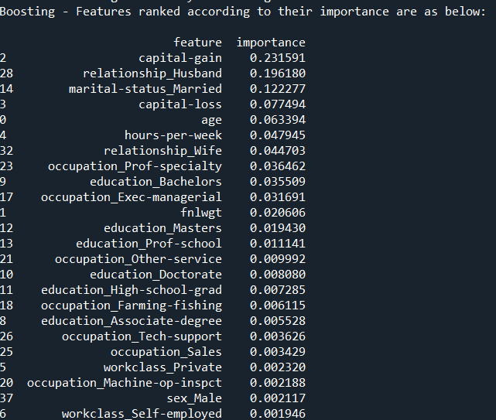
Gradient Boosting Model Evaluation
16
Following is model evaluation of Gradient Boosting model on Census data using GridSearchCV using 5-Fold CV.
The F1 score of 0.705, which represents the harmonic mean of precision and recall, indicates the balance between the two metrics.
An accuracy of 0.86596 indicates that the classifier is able to correctly classify approximately 86.59% of the instances in the testing set.
In summary, the results suggest that the Gradient Boosting classifier with the specified parameters and 5-fold cross-validation demonstrates a reasonable good ability to handle the binary classification problem.
Best parameters : Learning rate: 0.1,Maximum depth of each tree (max_depth): 4,Number of estimators (n_estimators): 300
Performed the best out of all the other models.
Imp features: capital _gain, relationship-Husband, marital-status _Married
Notes:
Maximizing the F1 score during the training and evaluation process, you prioritize the classifier's ability to handle imbalanced classes, where one class may have fewer instances than the other. The F1 score is particularly useful in such cases as it considers both false positives and false negatives.

Slide 17
Results and Conclusions
17
Based on these results, we can draw some conclusions:
Gradient Boosting outperforms the other three models in terms of both accuracy (0.866) and F1 score (0.705). Therefore, it seems to be the most effective model among the four.
Logistic Regression: Tuning the threshold really helped improving F1 score.
Gradient Boosting exhibits a better balance between precision and recall, as indicated by its higher F1 score. This suggests that it can effectively handle both false positives and false negatives, making it a more reliable model.

Slide 18
Final Thoughts
18
Challenges
Handling categorical variables: We were confused about which technique to use (Label Encoding/One hot encoding) as some categorical variables had a high number of unique values and one hot encoding was leading to 107 features, which would have been tough to interpret. So we decided to recategorize (bucket) some categories based on logic, with minimal loss of information/meaning.
Running GBT with > 10 candidate values for each of three hyperparameters due to computational and time limitations. Despite the model running an entire night (>12 hours), did not get a result. So we had to restrict candidate values to 2 or 3 and over a smaller range of values.
Learnings
Data preprocessing: Took 70-80% of time we spent on the project.
Apply learnings from the course by training 4 models and tuning hyperparameters for each.
Working on assignments where direction was given v/s taking your own direction (completely different).
Things we would have done if we had more time
Definitely PCA to reduce dimensionality - Analysing PCA variance ratios and dropping features step-wise with the least ratios.
Bagging and KNN.
Regularization methods to our log regression model.

